Slide 1
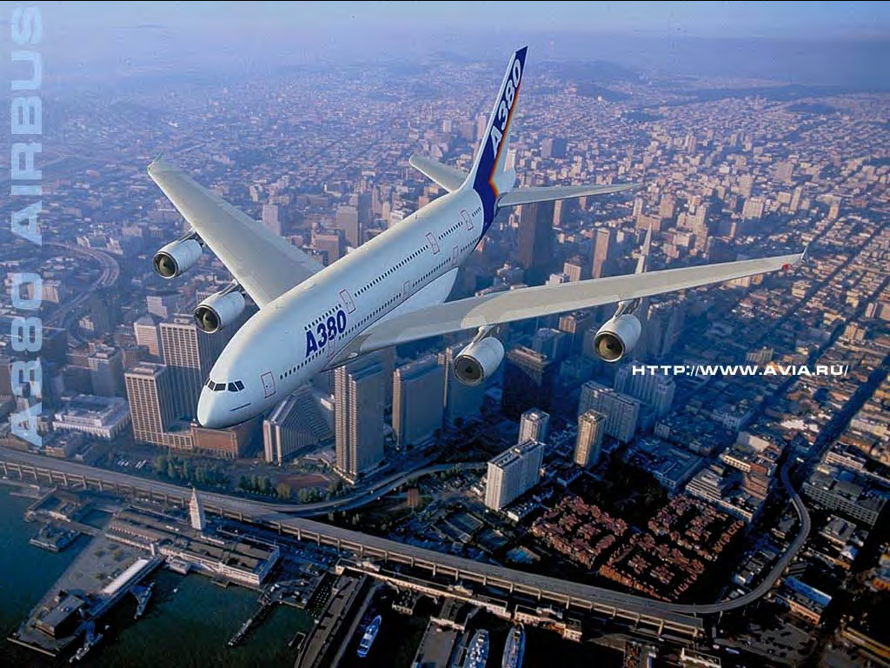
AIRPORT ENGINEERING

Slide 2


Slide 3
PART (C) - AIRPORT ENGINEERING
NO | CONTENT | MARKS
1 | INTRODUCTION TO AIRPORT ENGINEERING Types of Airport. Location and orientation of an airport . | 10
2 | COMPONENTS OF AN AIRPORT Runways, run way markings brief description Taxiways, brief description Aprons, brief description Airport layout | 12
3 | AIRPORT LIGHTINGS Lighting of approaches. Runways. Taxiways. Landing area | 8

Slide 4
1. INTRODUCTION TO AIRPORT ENGINEERING
Air transport is the gift of 20th century to the world.
It is the latest means of transport.
It is used successfully in 1st world war.
First service is started between Landon & Paris in 1919.
Since then it has made a notable progress.
Air travel is the fastest means to reach in any part of the world.
Air India & Indian air lines.
Exorbitant rate have made it the mode of transportation of the rich community.

Slide 5
ADVANTAGES:
High speed.
Quick service.
No infrastructure investment.
Easy access.
No physical barrier.
Natural route.
Continuous journey.
National defense.
DIS ADVANTAGES:
Risky.
Very costly.
Small carrying capacity.
Unreliable.
Huge investment.

Slide 6
COMPARISON BETWEEN ROAD AND AIR TRANSPORT
ROAD TRANSPORT
AIR TRANSPORT
Undertaken through artificial tracks and ways.
Involves small investment.
Speed of transport vary according to the nature of vehicle.
Useful for internal trade.
Carried on over a short distance.
Freight rate of this type of transport is usually low.
Undertaken through natural tracks and ways.
Involves large investment.
Speed of this type of transport is fastest.
Useful for internal & external trade.
Carried on over any distance.
Freight rate of this type of transport is usually very high.

Slide 7
AIRPORT ENGINEERING
Airport engineering involves design and construction of a variety of facilities for the Landing, Takeoff, movement on ground, parking, maintenance and repair of airplanes, fuel storage, handling of passengers and baggage.

Slide 8
AIRPORT CLASSIFICATION
Airports are classified in different ways in different countries.
In India we classified as Civil & Military.
Military airports are mainly meant for military aircrafts only.
The civilian airports can be for military purpose also.
Civilian airports can be a Minor, Intermediate, Major & International airports.
For the development of airports and airways the Government of India under the Ministry of civil aviation, established two public sector enterprises.

Slide 10


Slide 11
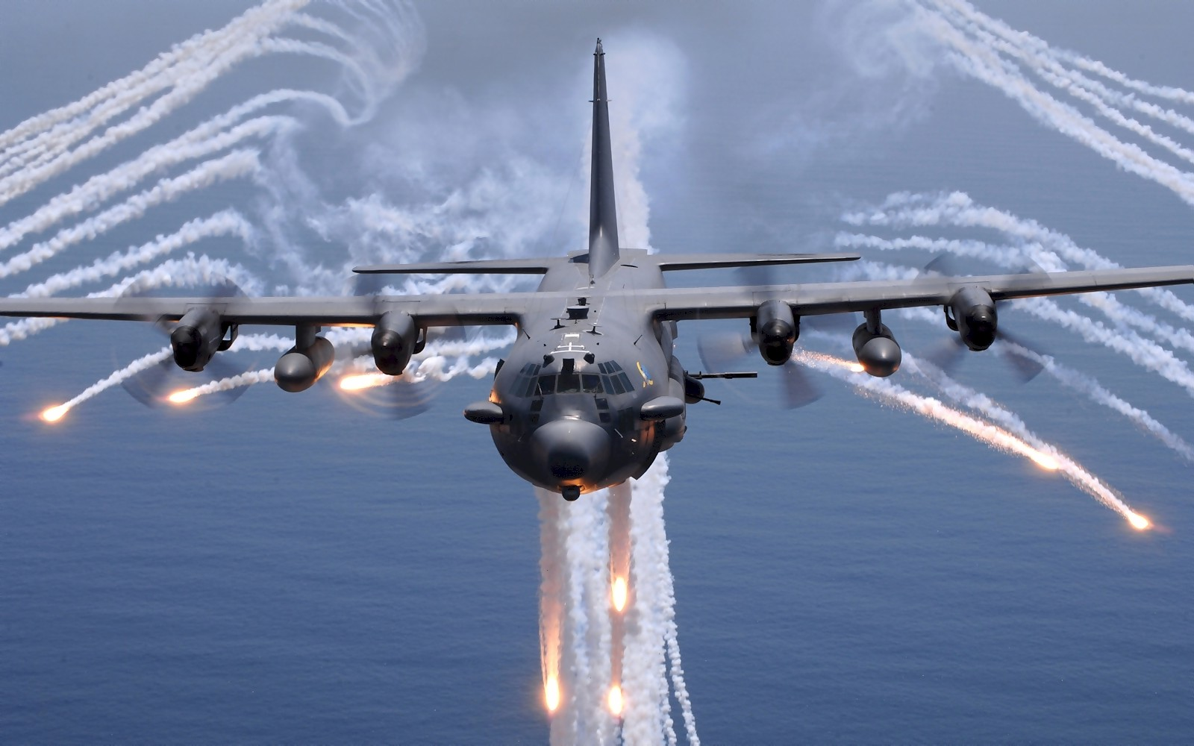

Slide 12
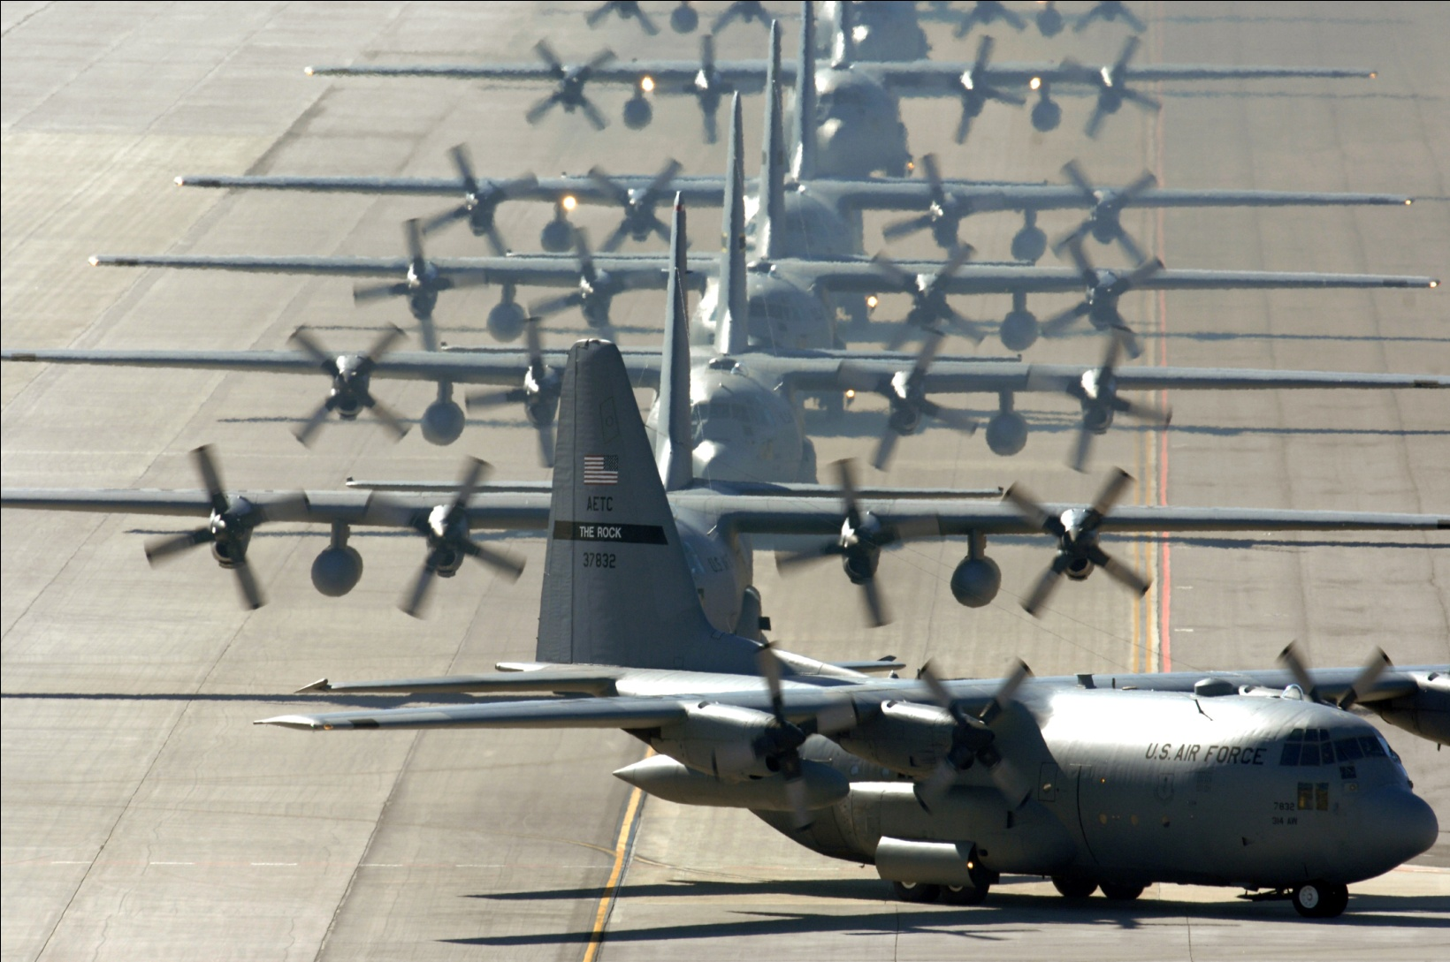

Slide 13
LOCATION AND ORIENTATION OF AIRPORT
Following are the factors which influences the location of an airport.
Future development.
Availability of utilities.
Development of surrounding area.
Airport use.
Topography.
Accessibility to the community.
Presence of other airport.
Obstruction.
Visibility.
Wind.
Economy of construction.

Slide 14
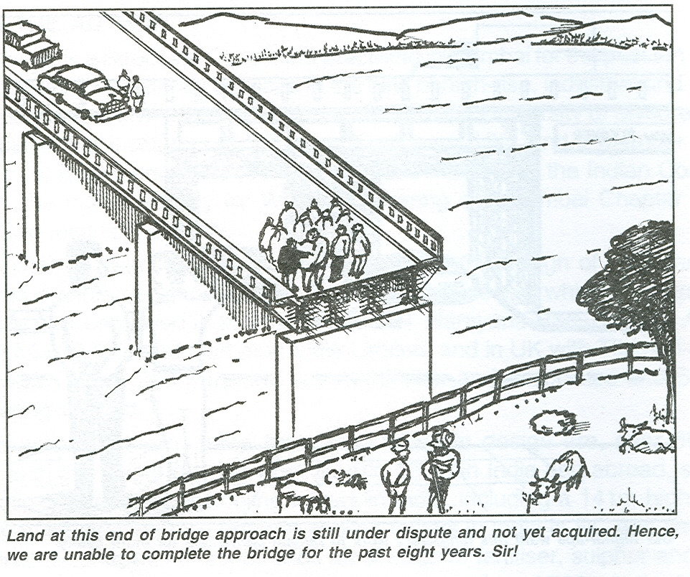

Slide 15
AIRPORT TERMINOLOGY
Following are the important term related to airport engineering.
Aerodrome.
Aeroplane.
Airfield.
Airport capacity.
Approach area.
Apron.
Beacon.
Flight visibility.
Fillet.
Hanger.
Holding apron.
Runway.
Taxiway.
Terminal building.

Slide 16
2. COMPONENTS OF AN AIRPORT
Following are the main components of airport
Runways.
Taxiways.
Aprons.
Terminal building.

Slide 17
RUNWAY
The number and orientation of runway plays an important role in the overall arrangement of various components of airport.
Number of runway depends on volume of traffic.
Orientation depends on direction of wind.
They must have a length and width adequate to accommodate the aircraft to be served.

Slide 18
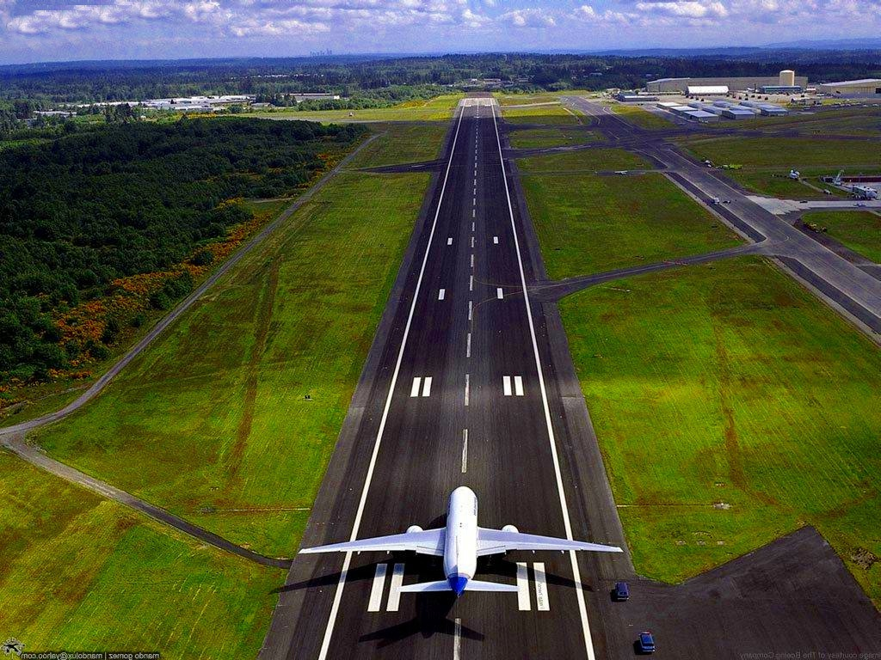

Slide 19
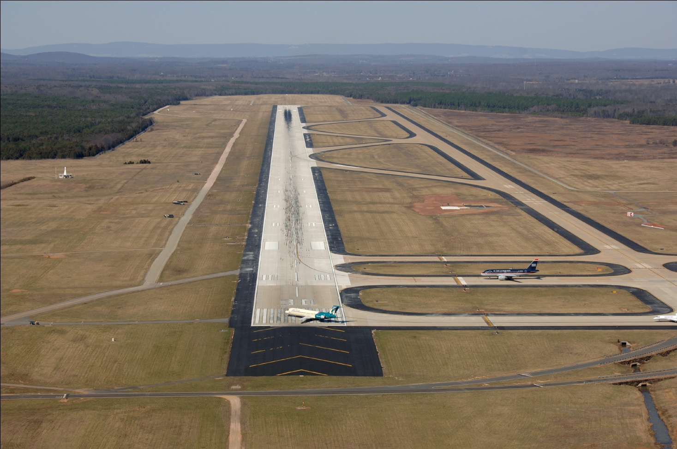

Slide 20
RUNWAY ORIENTATION
Usually oriented in the direction of prevailing winds.
Head wins i.e. the direction of wind opposite to the direction of landing.
Provides greater lift on the wings of the aircraft when it is taking-off.
Provides breaking effect and the aircraft comes to a stop in a shorter distance.

Slide 21
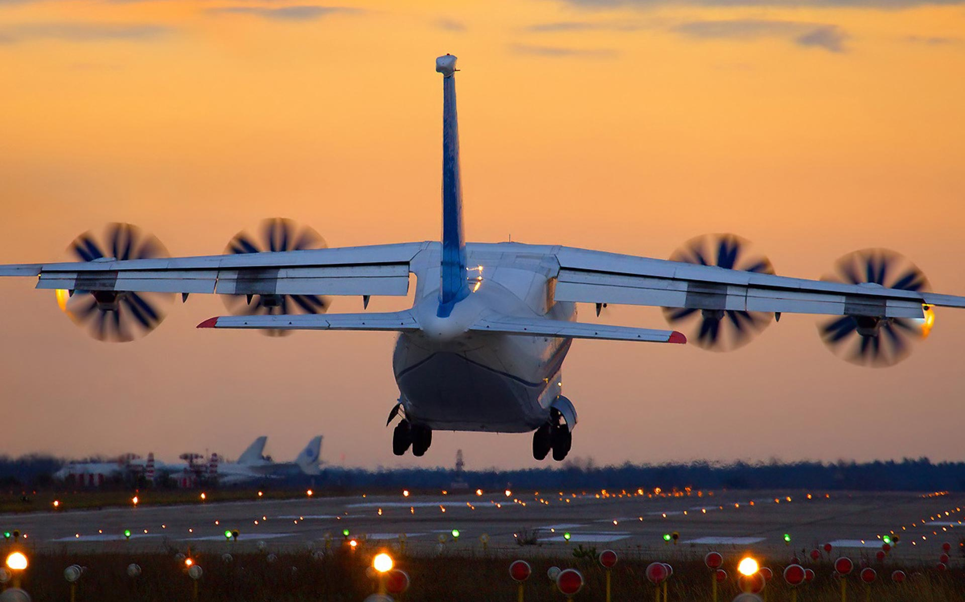

Slide 22
Runway configurations
Single runway.
Intersecting runway.
Parallel runway.
Divergent runway.

Slide 23
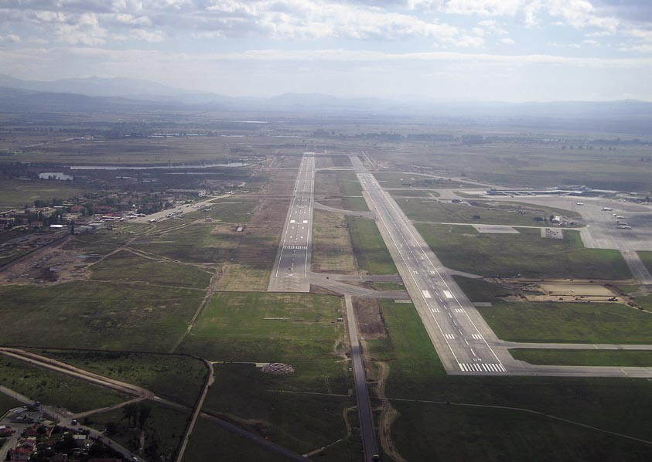

Slide 24
Runway Marking
Runway centre line marking.
Runway Edge strip Marking.
Runway numbering.

Slide 25
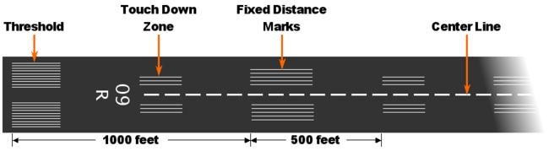

Slide 26
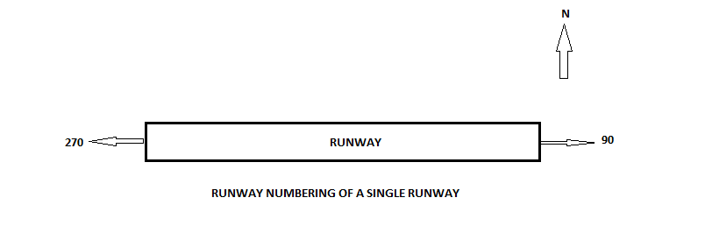
RUNWAY NUMBERING
27
9

Slide 27
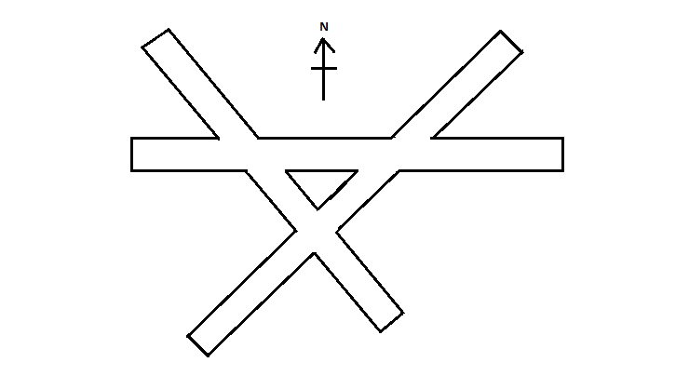

Slide 28
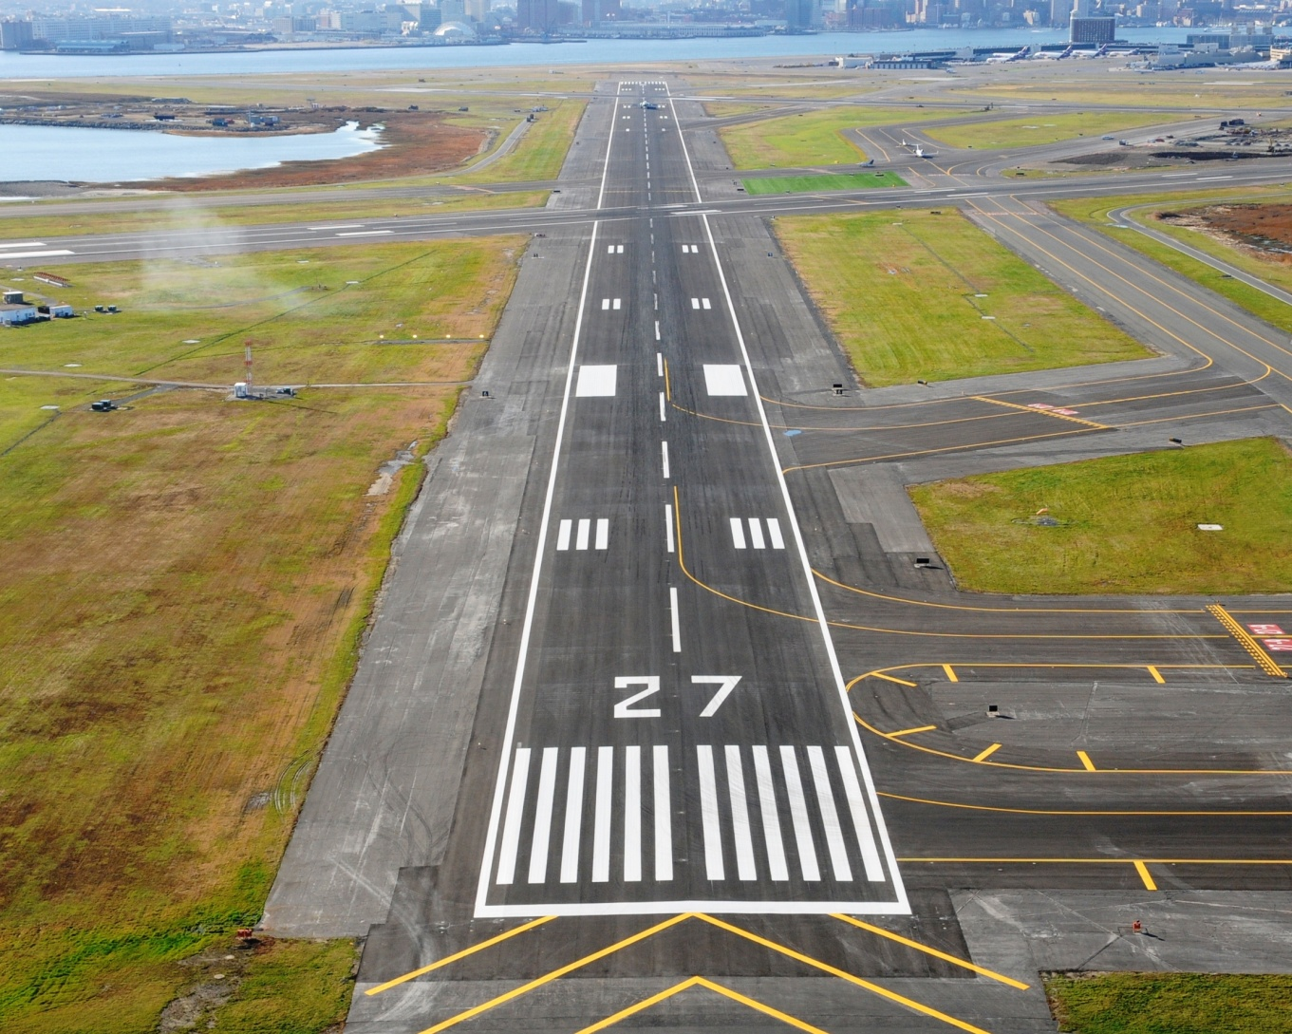

Slide 29
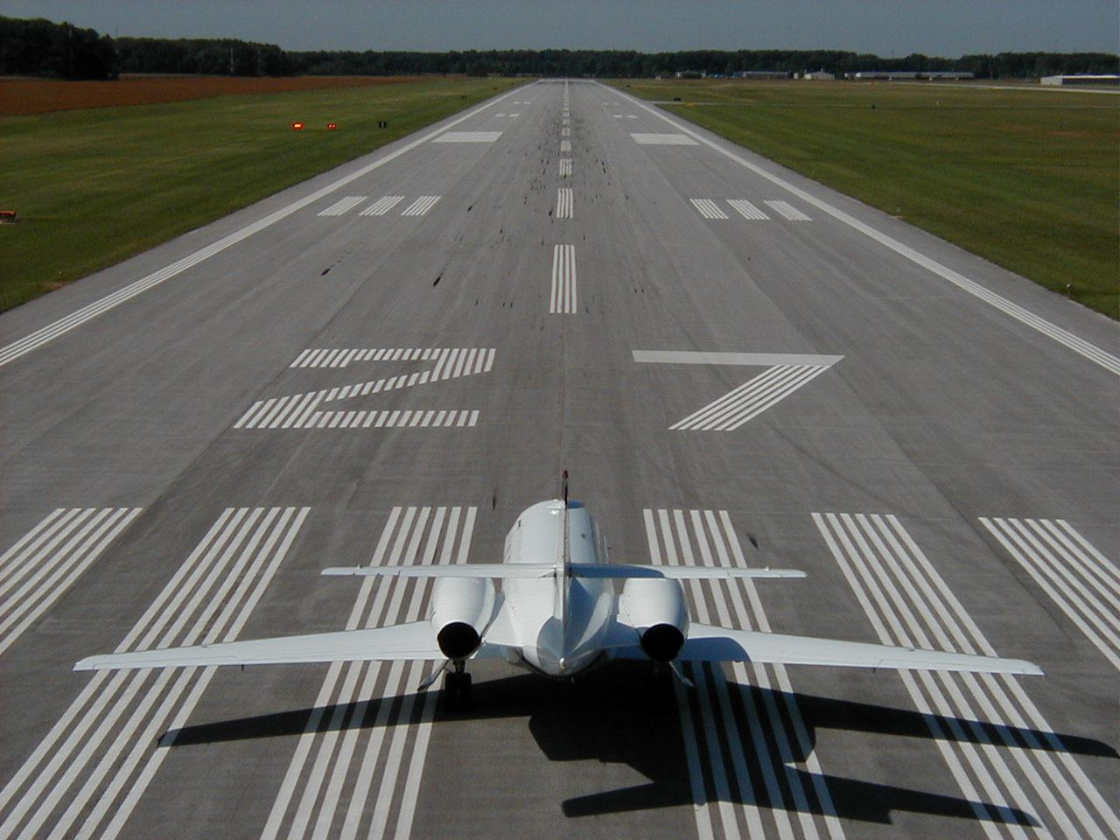

Slide 30
TAXI WAY

Slide 31
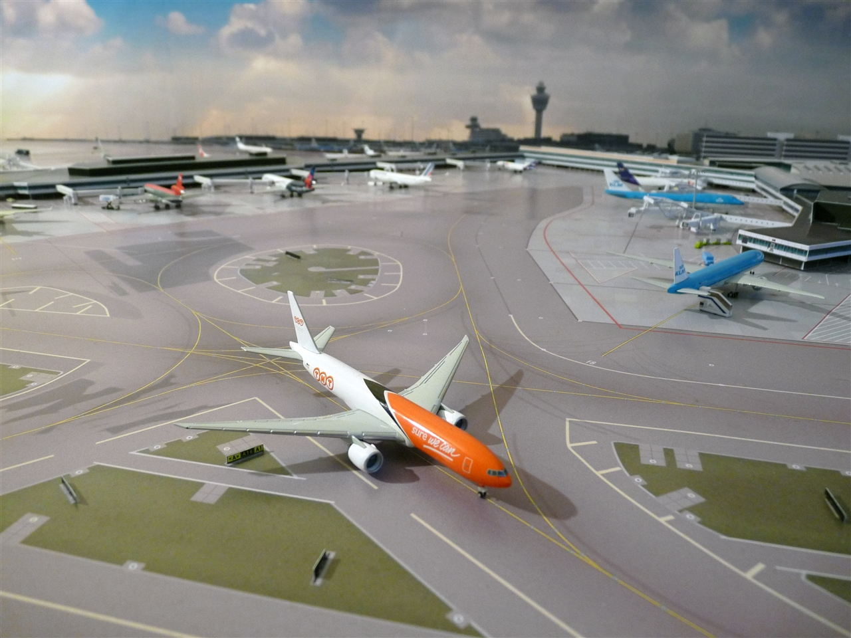

Slide 32
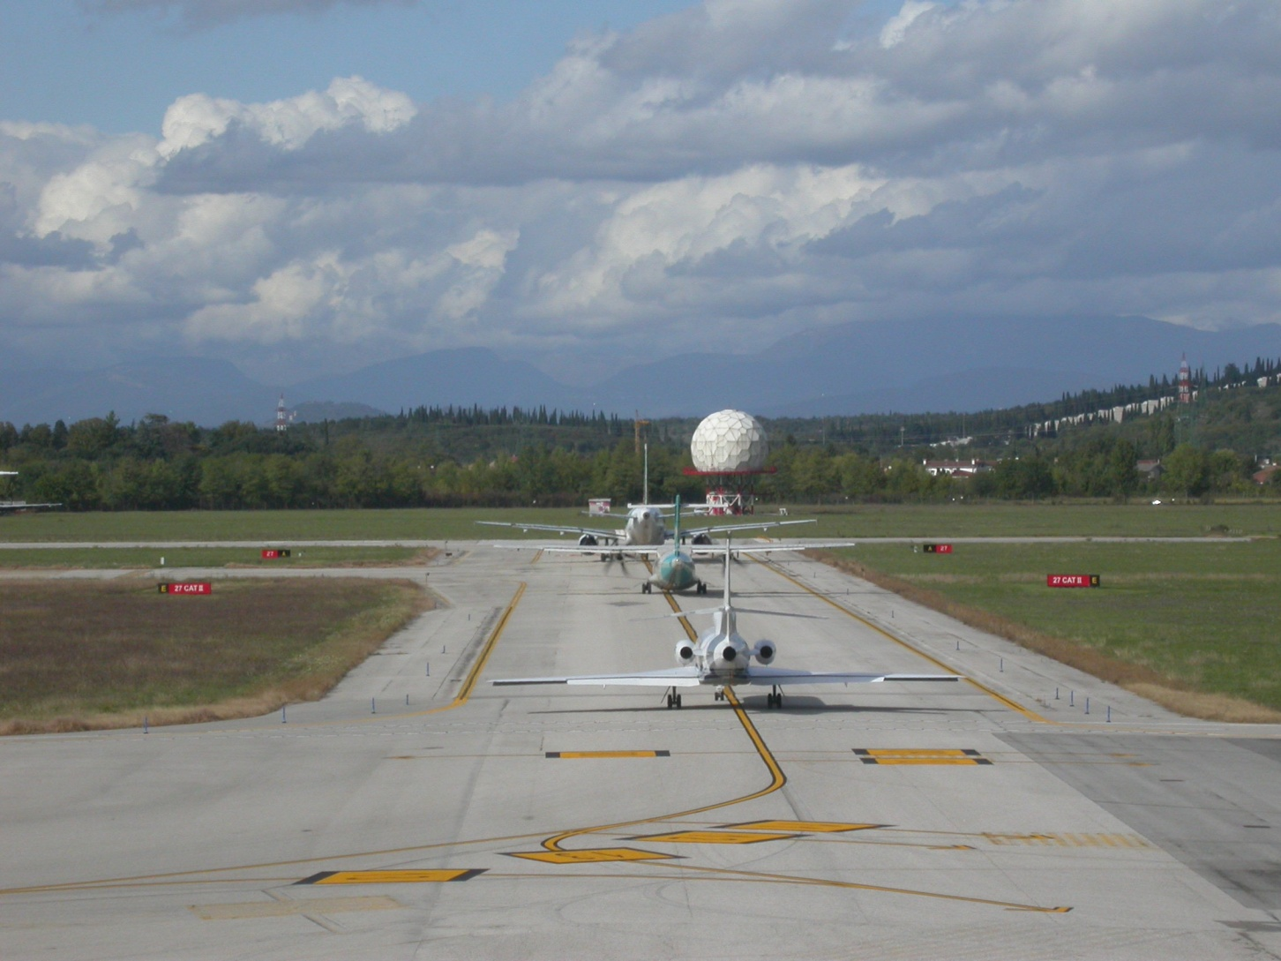

Slide 33
AIRPORT TERMINAL BUILDING
Building which mainly used for the passengers, aircraft staff and administration management.
Passenger handling counter.
Baggage handling counter.
Baggage claim section.
Enquiry counter.
Public telephone booth.
Waiting hall for passengers.
Toilets.
Restaurants & Bars.
First aid room.
General store.
Gift shop.
Post office and banking facilities.
Custom control.

Slide 34
Systems of aircraft parking
Frontal or linear system.
Open-apron or transporter system.
Pier or finger system.
Satellite system.

Slide 35
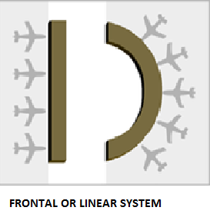

Slide 36
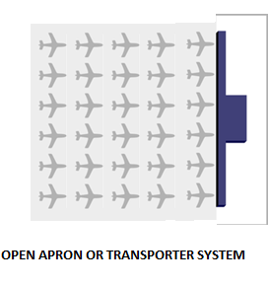

Slide 37
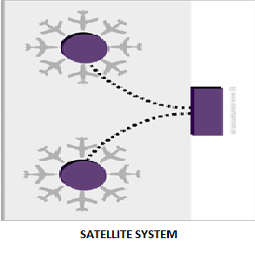

Slide 38
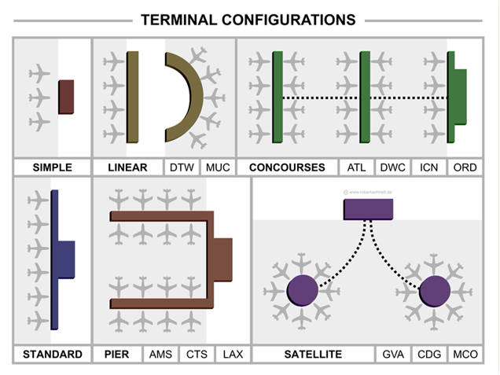

Slide 39
AIRPORT CAPACITY
The number of aircraft movements which an airport can process within a specified period of time.
Runway configurations.
Characteristics of aircraft.
Loading apron space.
Aircraft processing techniques.
Number of gates in apron area.
Number of arrivals.
Weather condition.
Wind conditions.

Slide 40
APRON

Slide 41
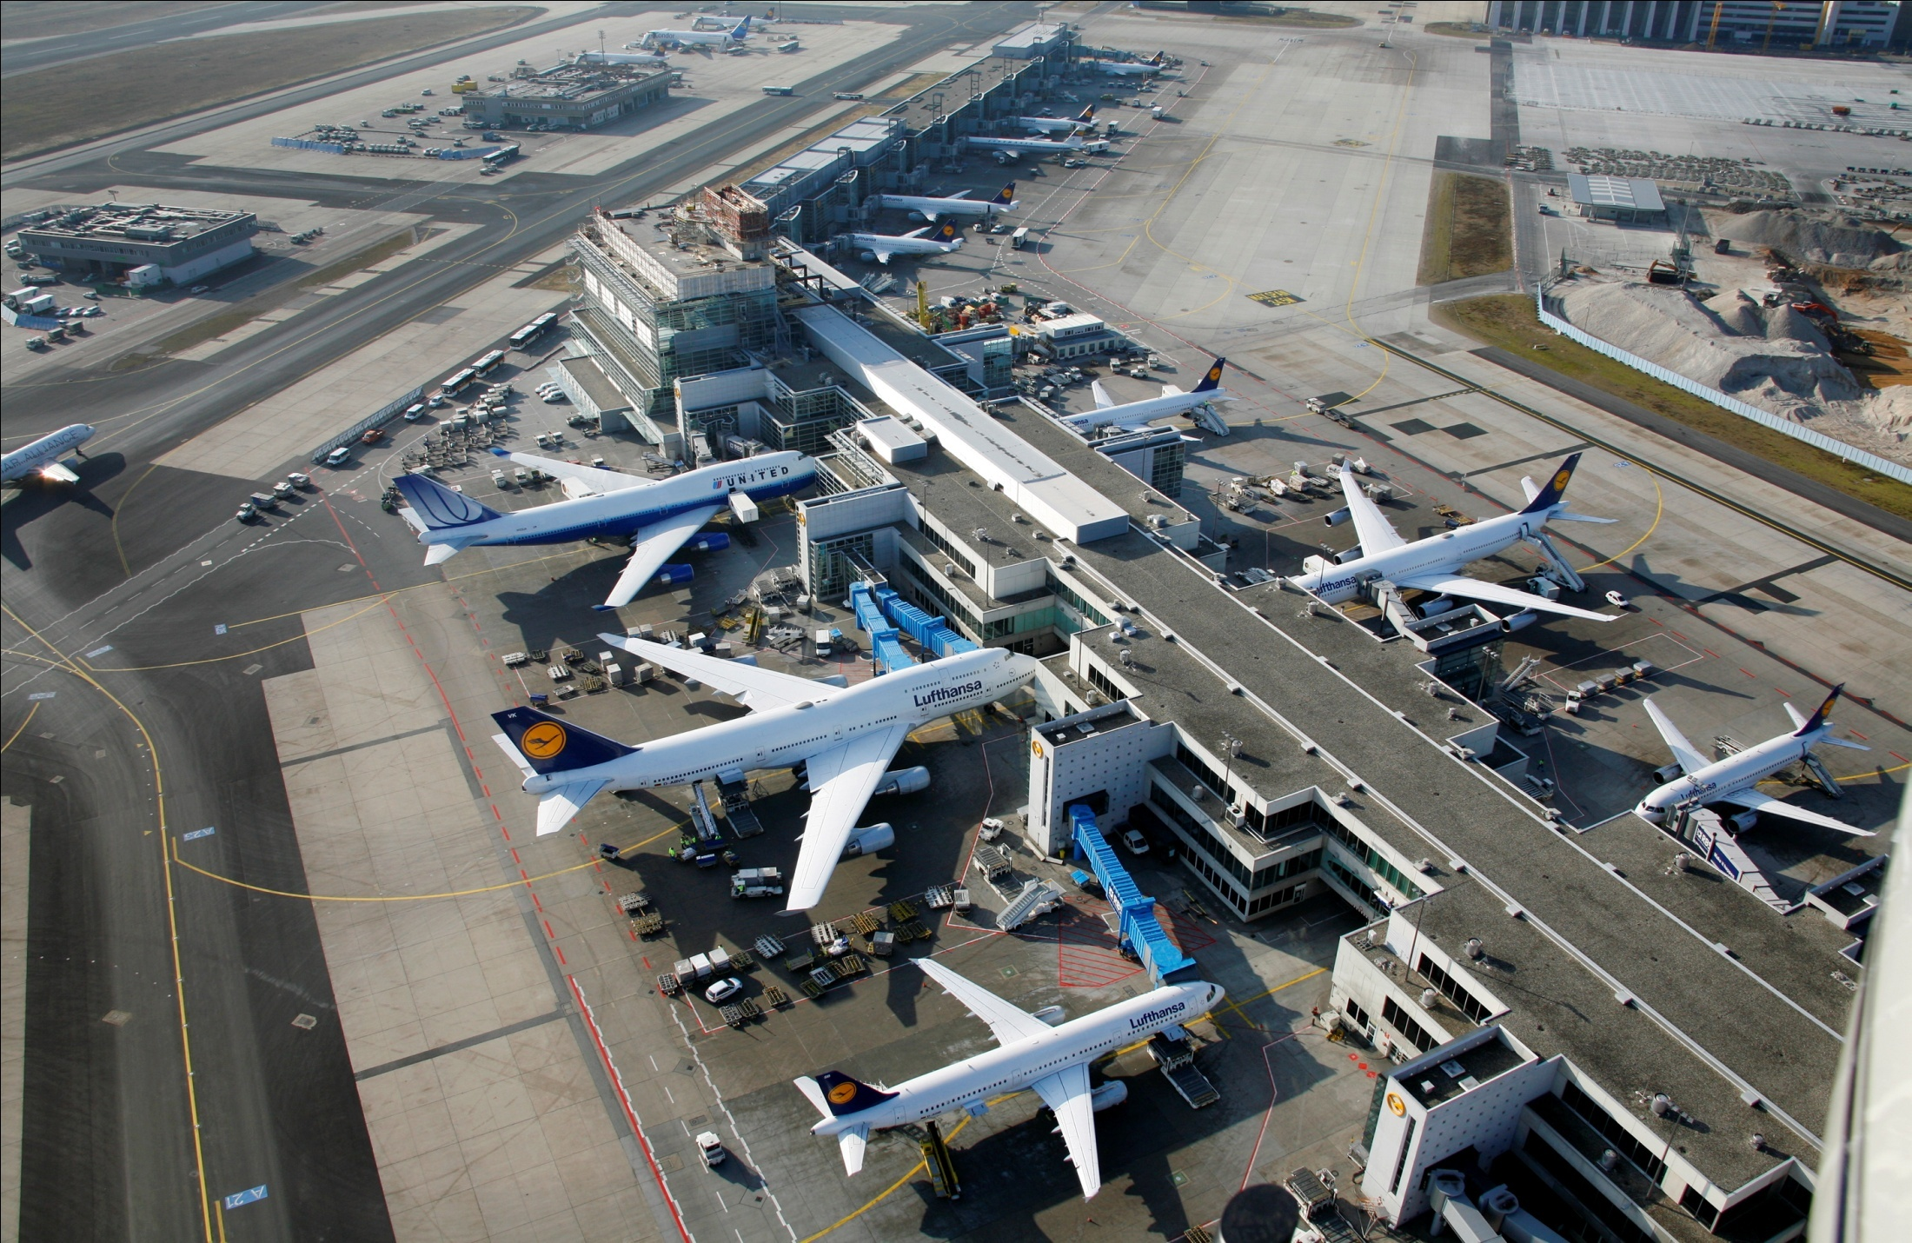

Slide 42
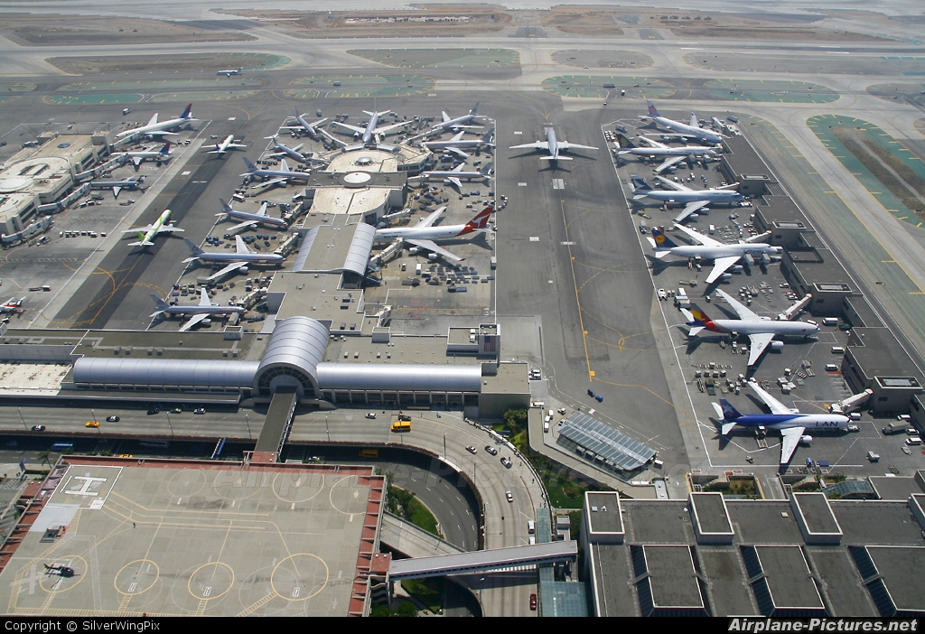

Slide 43
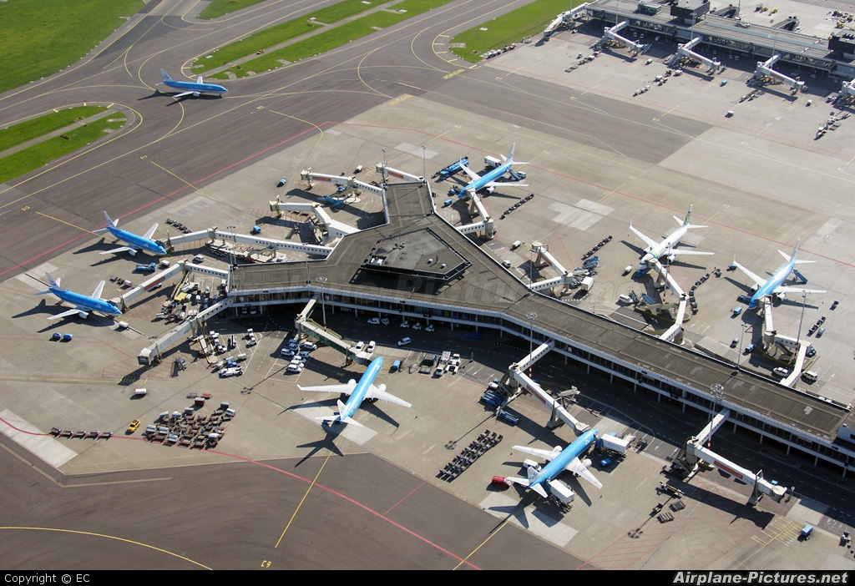

Slide 44
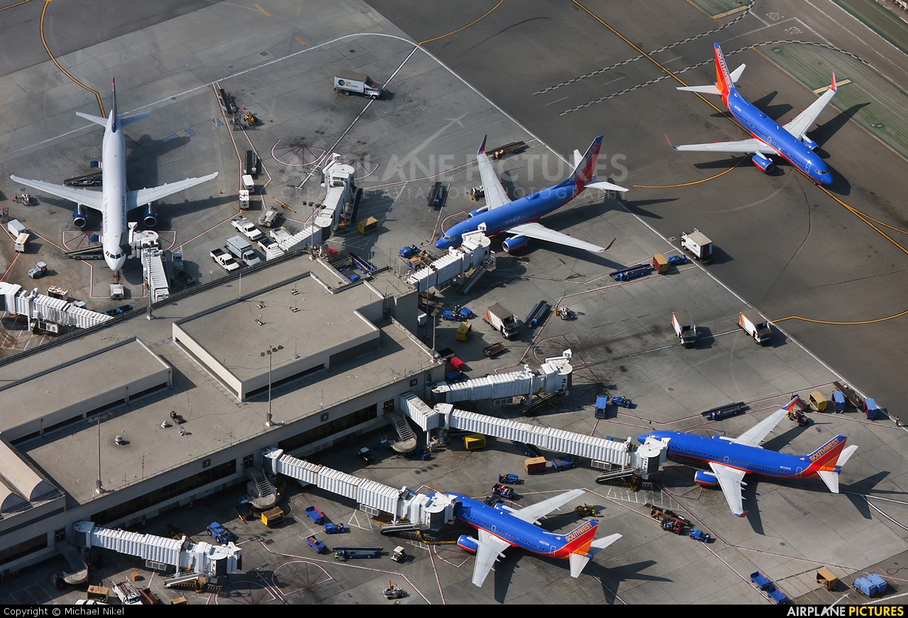

Slide 45
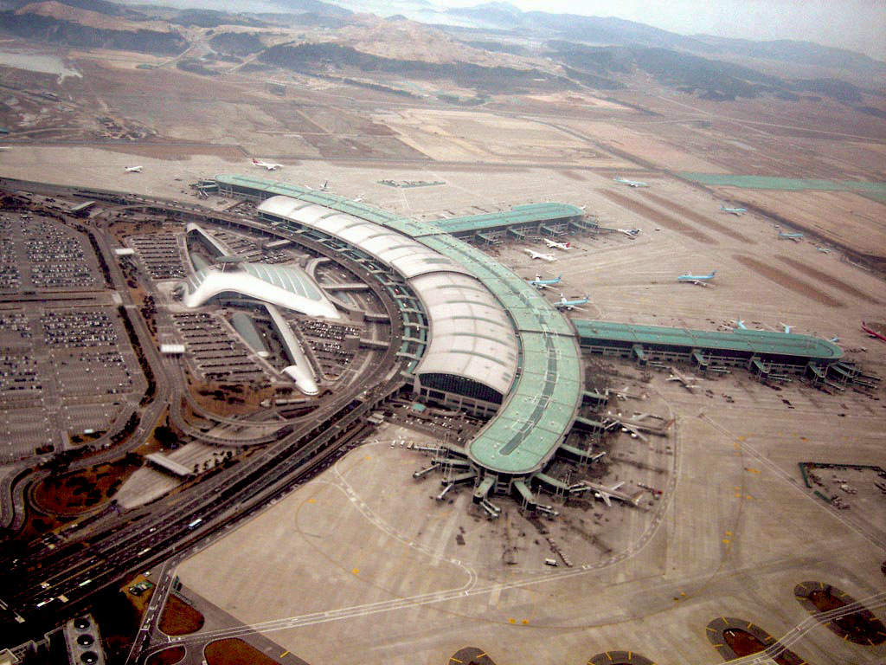

Slide 46
HANGER

Slide 47
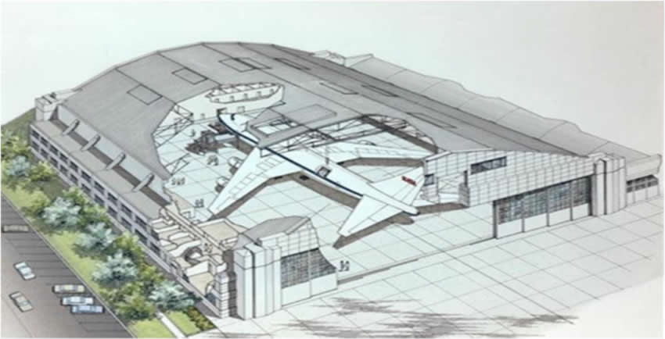

Slide 48
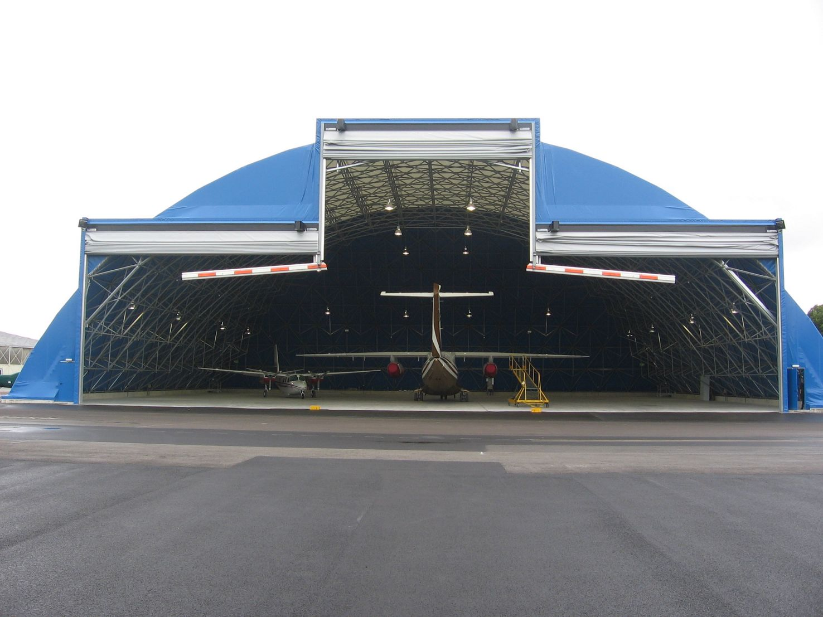

Slide 49
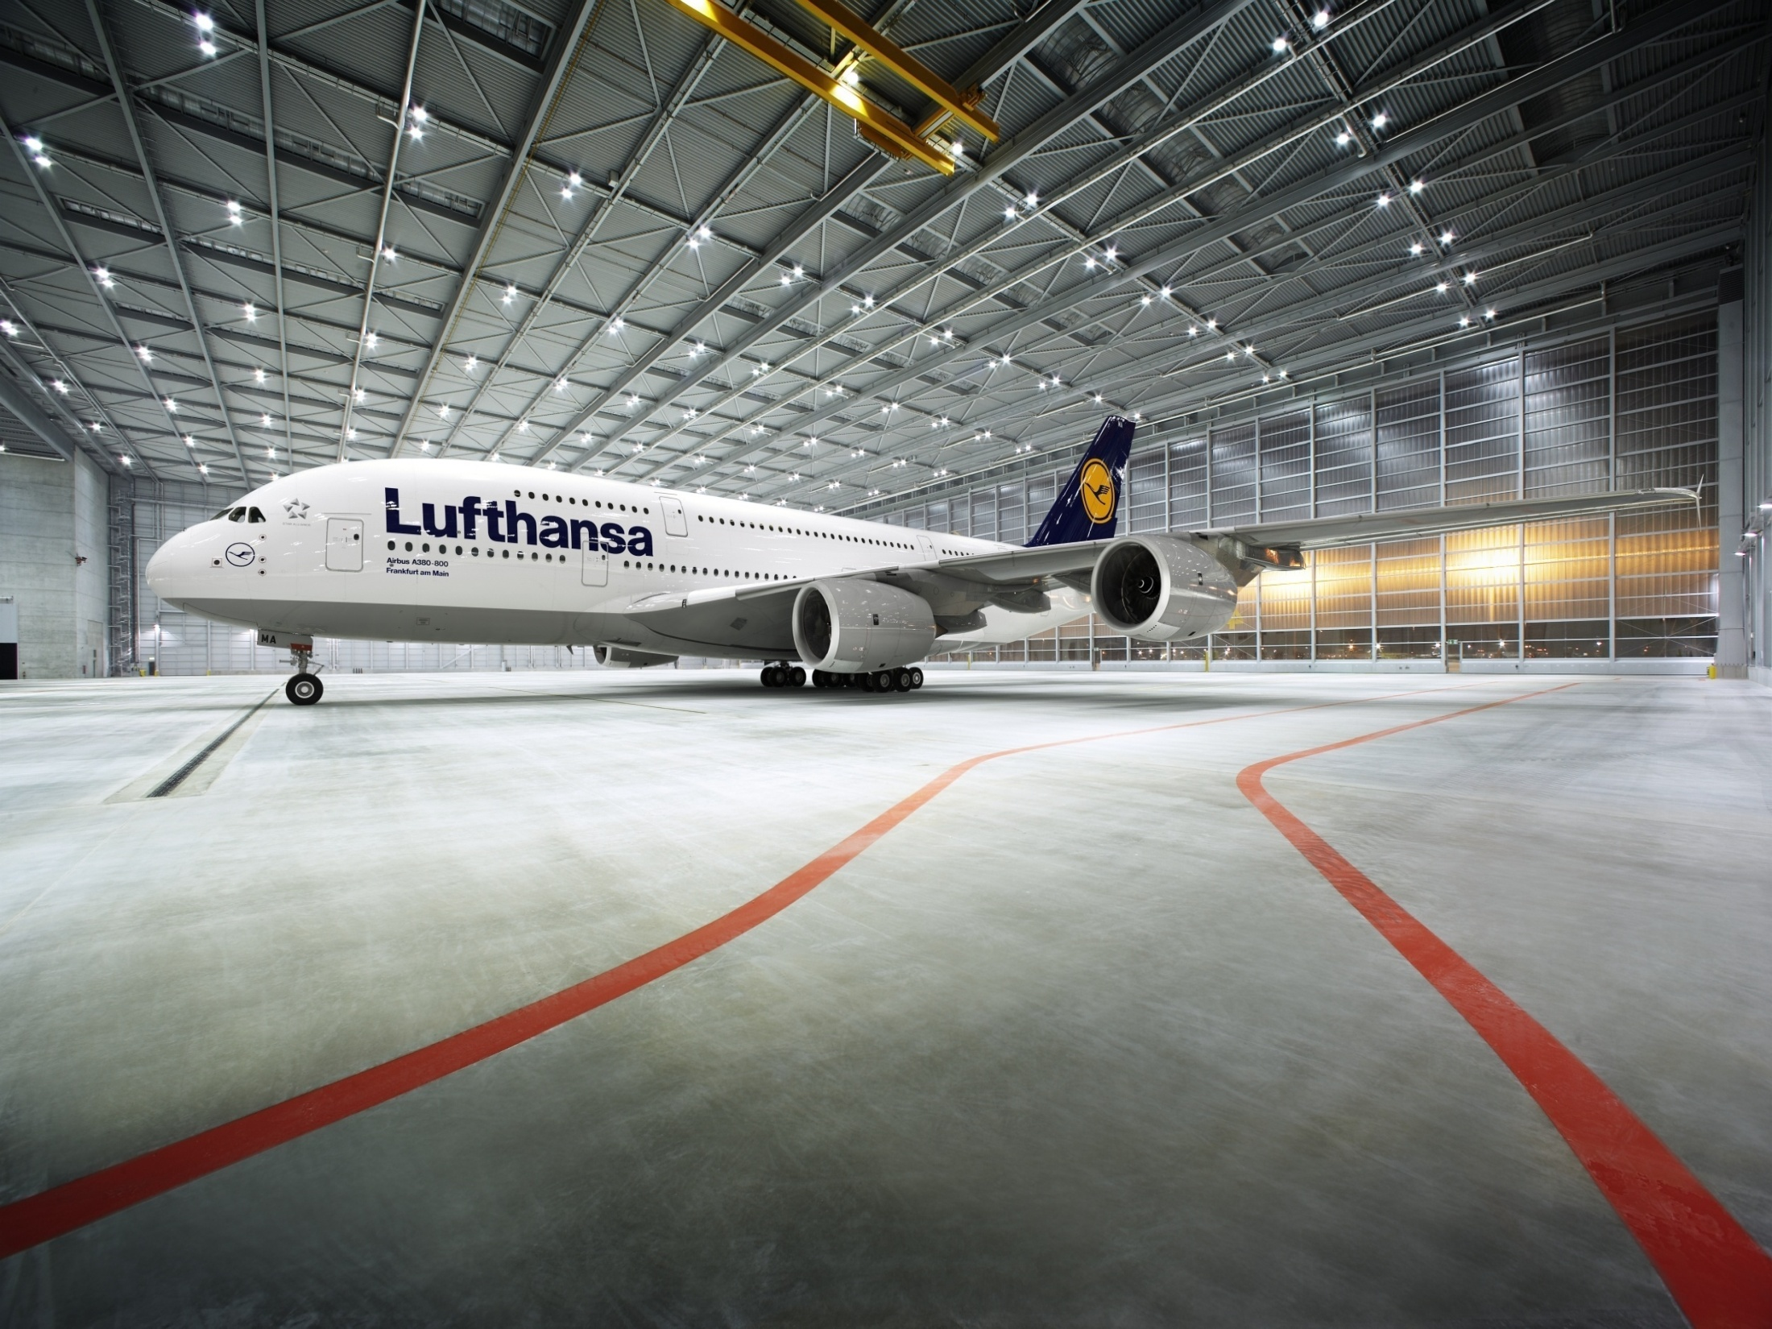

Slide 50
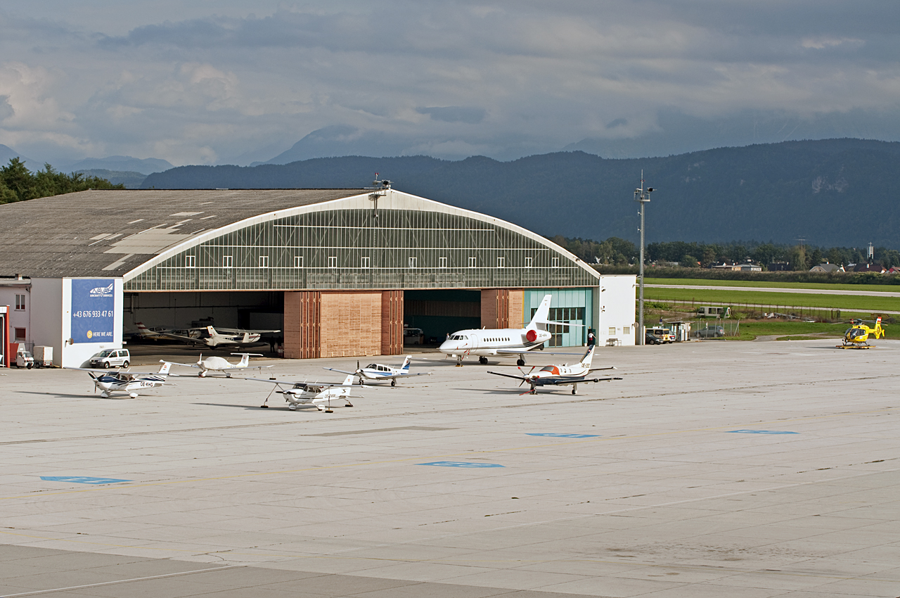

Slide 51
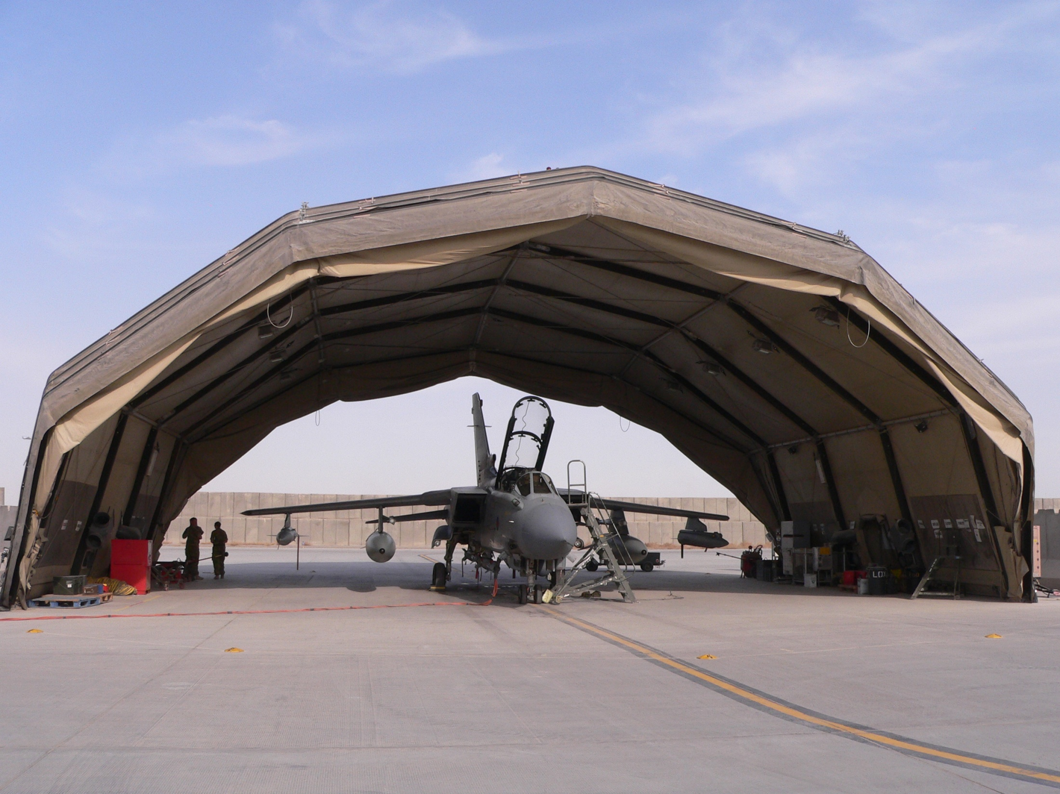

Slide 52
AIRPORT LAYOUT
Number of orientation of runway
Number of taxiways.
Size and shape of apron.
Available land.
Topography.
Soil condition.
Obstacle.
Proximity.
Surrounding land use.
Timing and Scale of phased development of Airport.

Slide 53
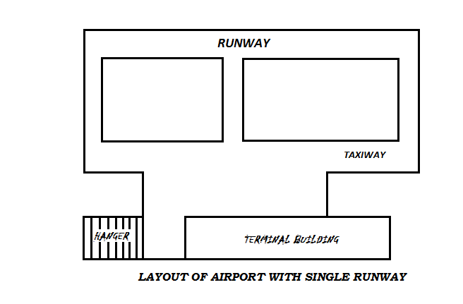

Slide 54
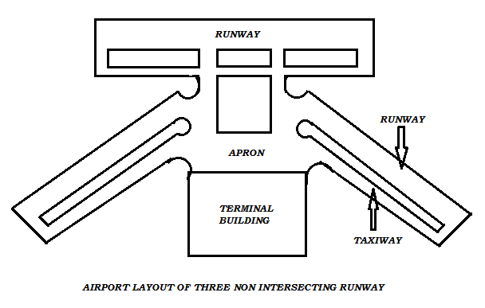

Slide 55
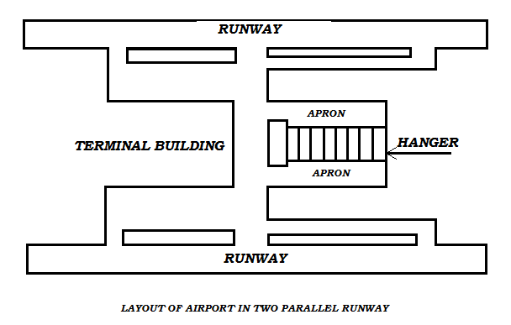

Slide 56
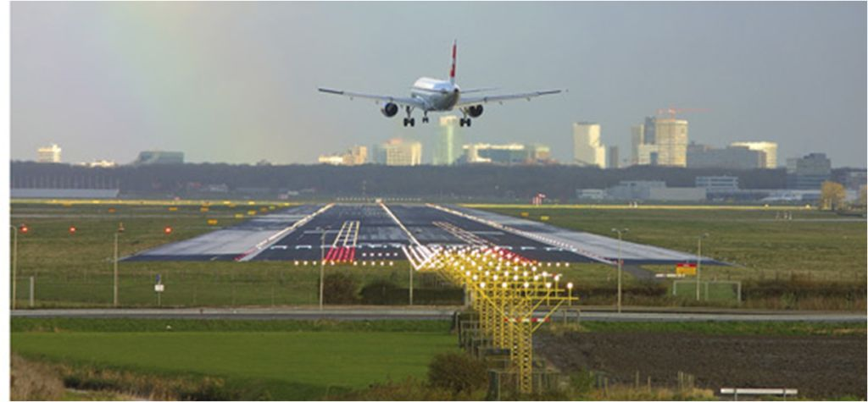

Slide 57
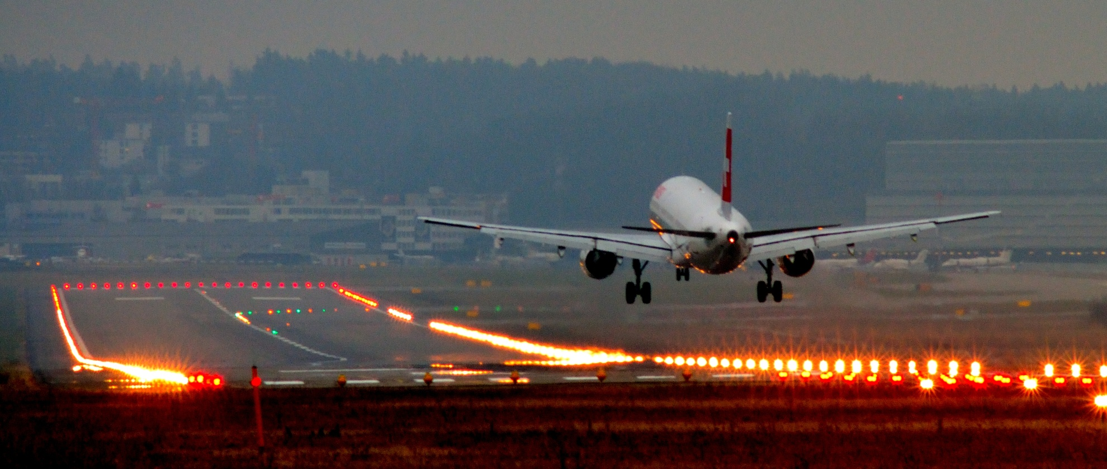

Slide 58
3.AIRPORT LIGHTINGS
Airport lightings provides illumination to keep the facilities available around the clock.
Lighting keeps assisting in location and identification of the airport.
Basic lighting consists of Beacon, Wind indicator, runway lighting, etc,.

Slide 59
FACTORS AFFECTING AIRPORT LIGHTINGS
Airport classification.
Amount of traffic.
Availability of Power.
Nature of aircraft using the airport.
Type of night operations.
Type of landing.
Weather conditions.

Slide 60
METHOD OF AIRPORT LIGHTINGS
Runway Lighting.
Threshold Lighting.
Approach Lighting.
Taxiway lighting.
Airport Beacon.
Wind Indicator.
Landing direction Indicator.
Boundary Lighting.
Apron Lighting.
Hanger Liffhting.

Slide 61
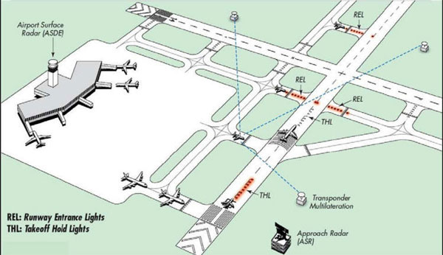

Slide 62
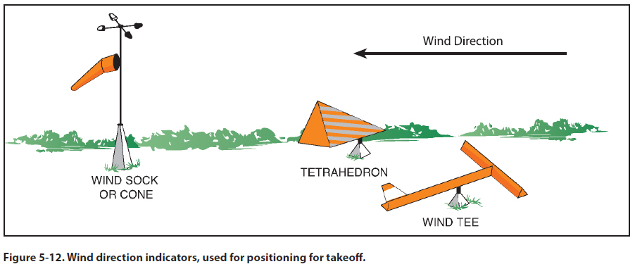
WIND INDICATOR

Slide 63
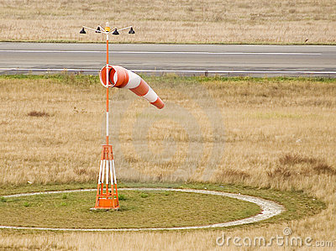
WIND INDICATOR

Slide 64
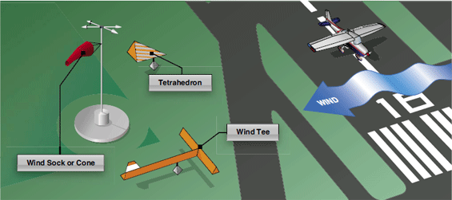
WIND INDICATOR

Slide 65
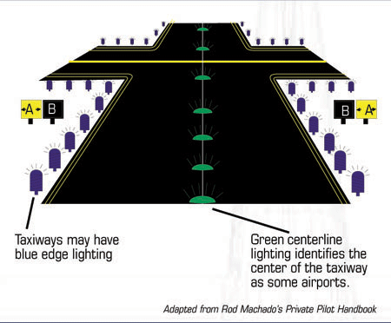

Slide 66
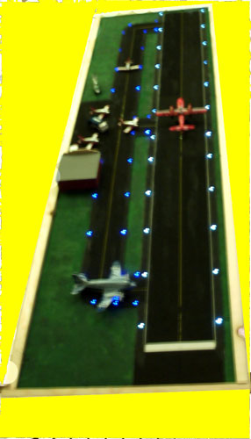

Slide 67
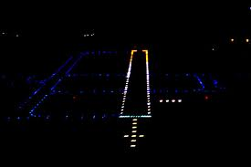

Slide 68
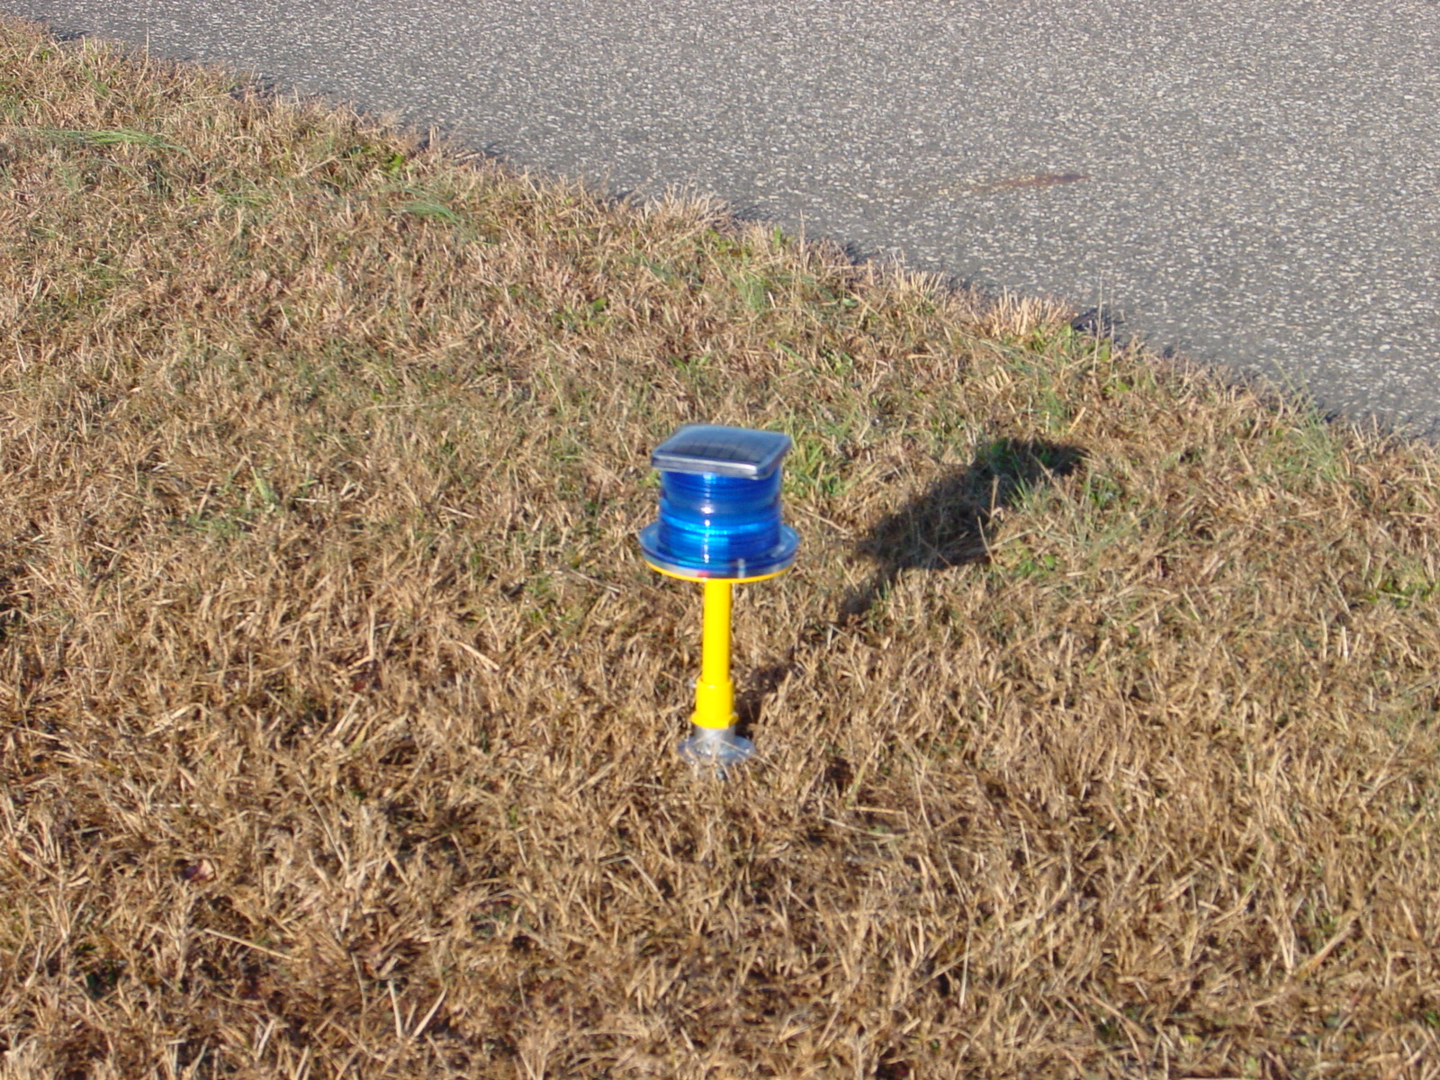

Slide 69
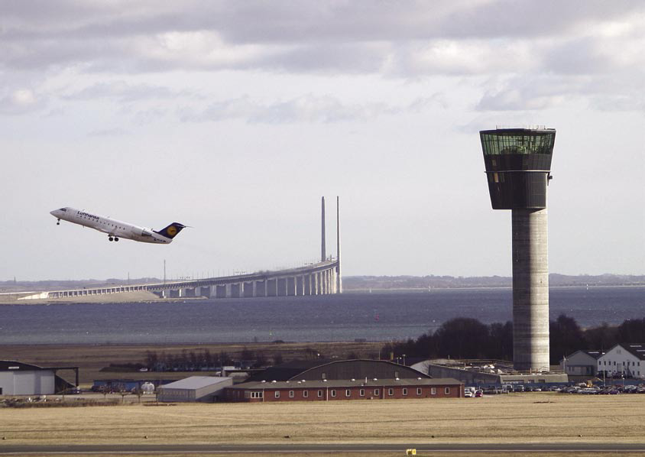

Slide 70
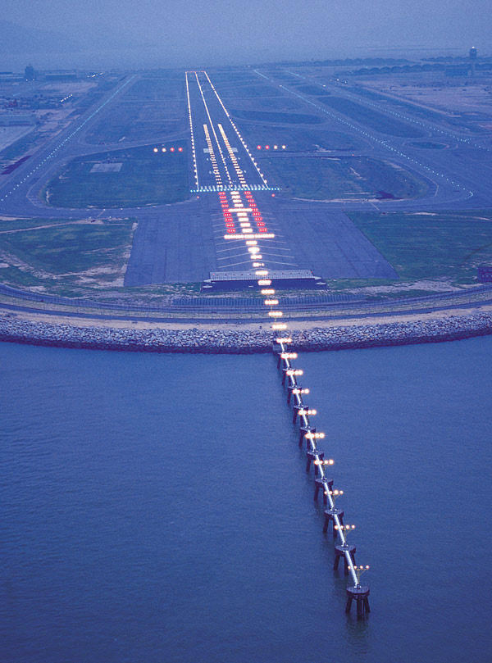

Slide 71
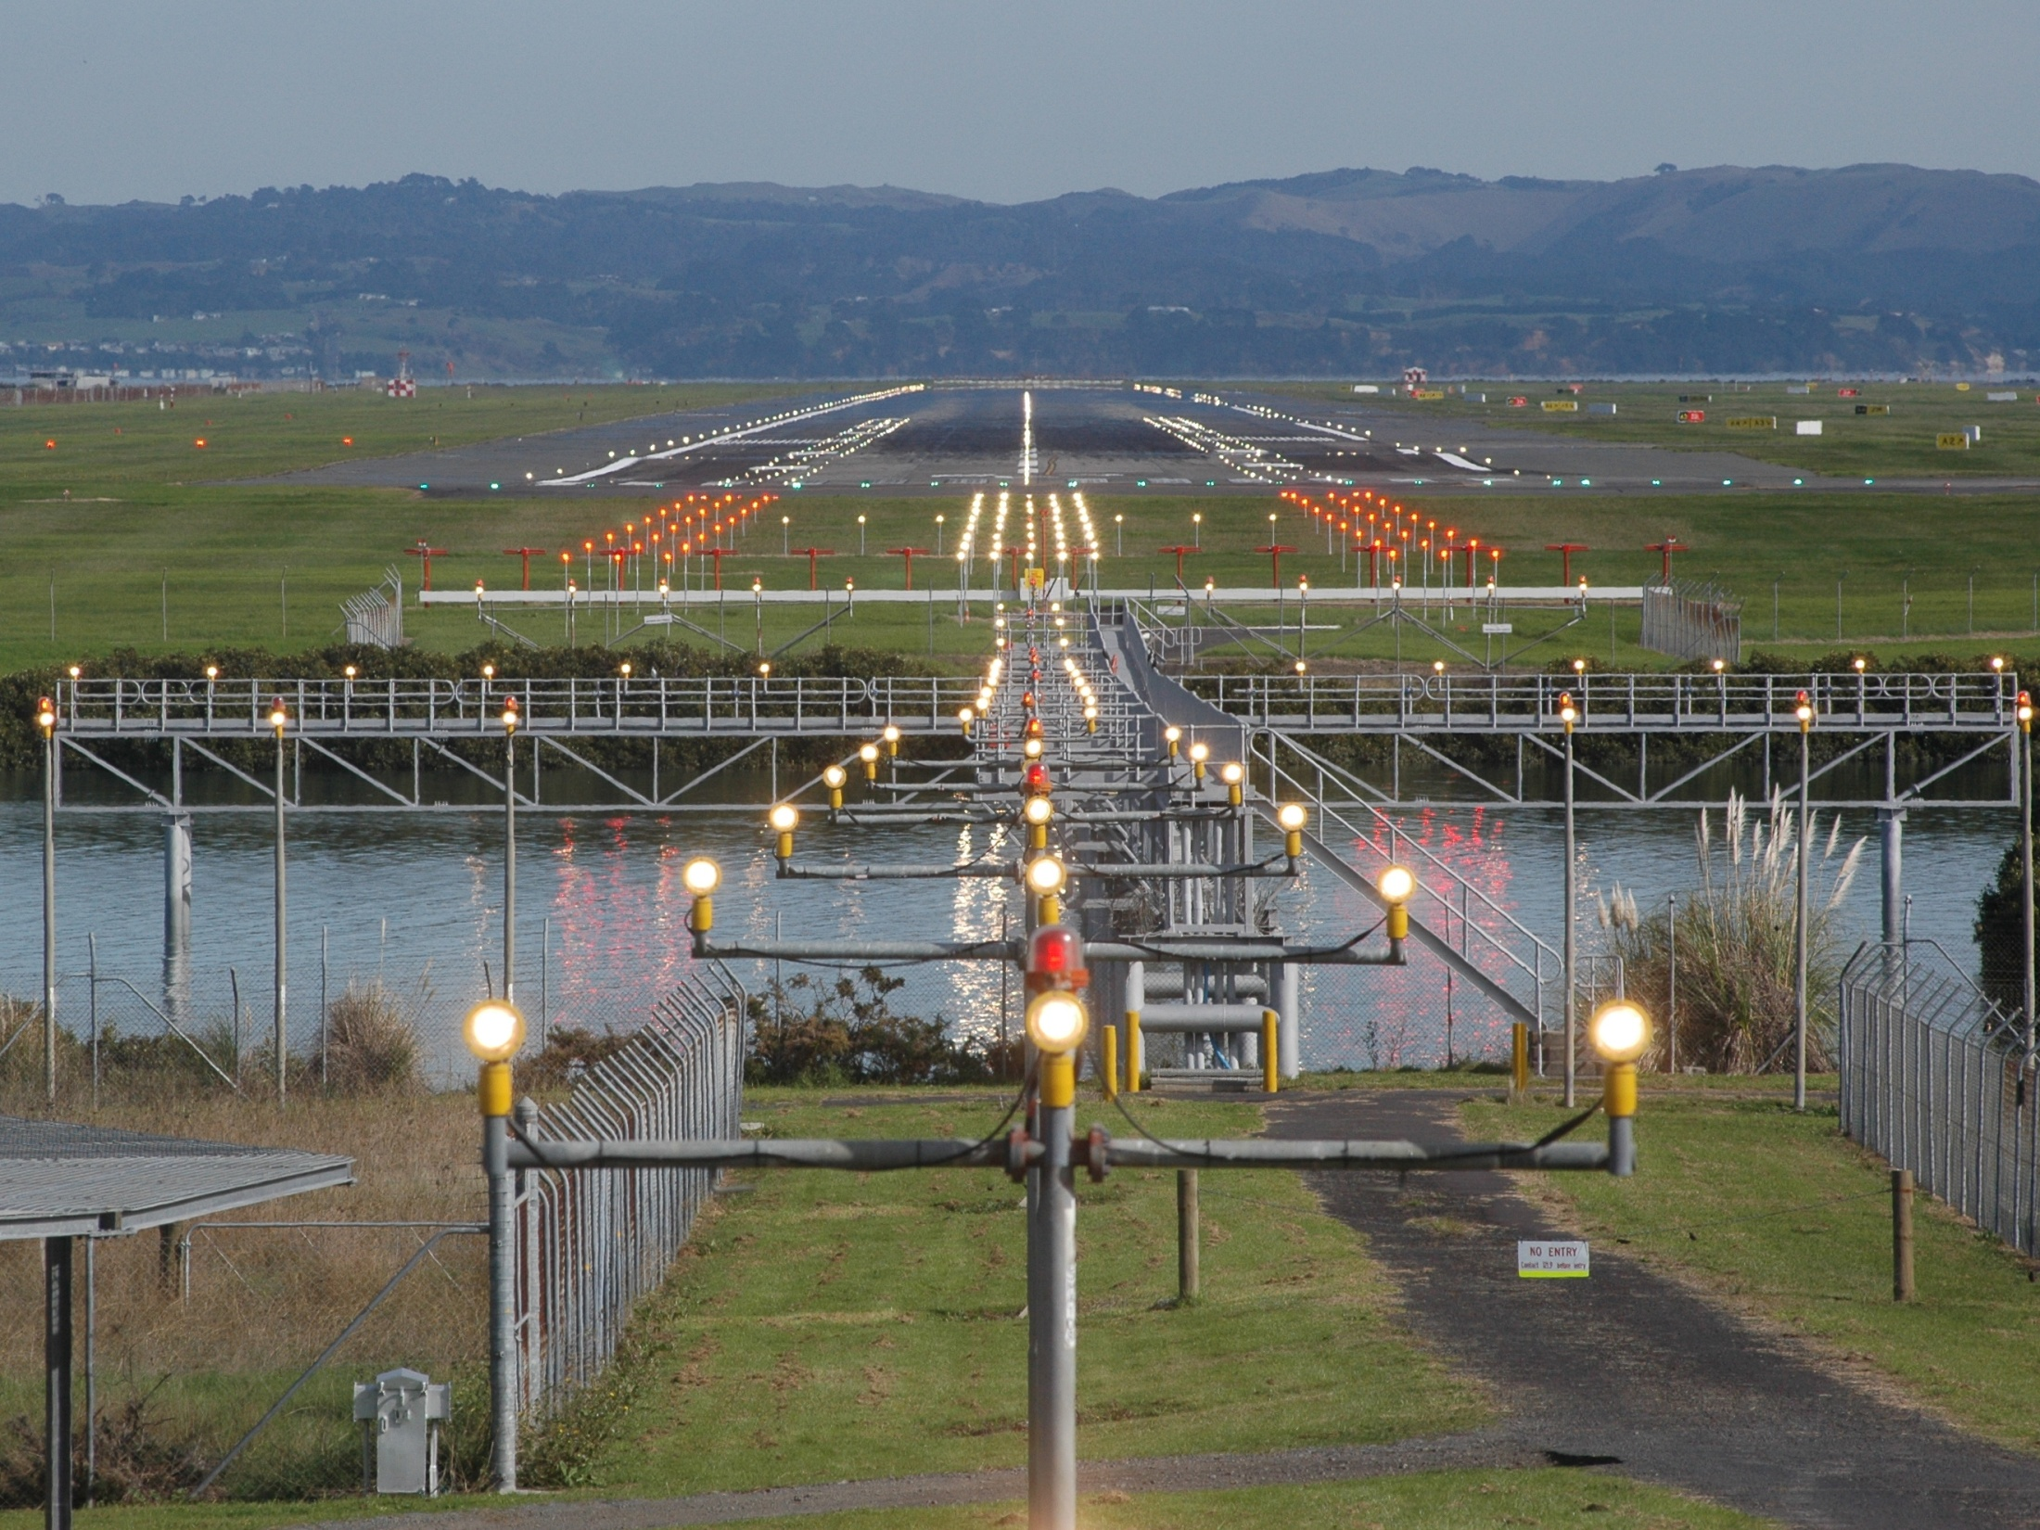

Slide 72
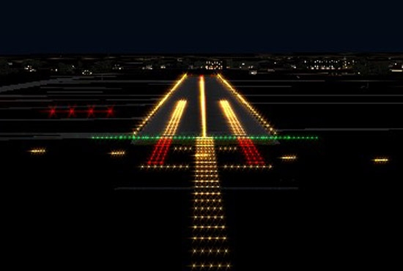

Slide 73
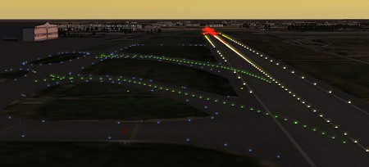

Slide 74
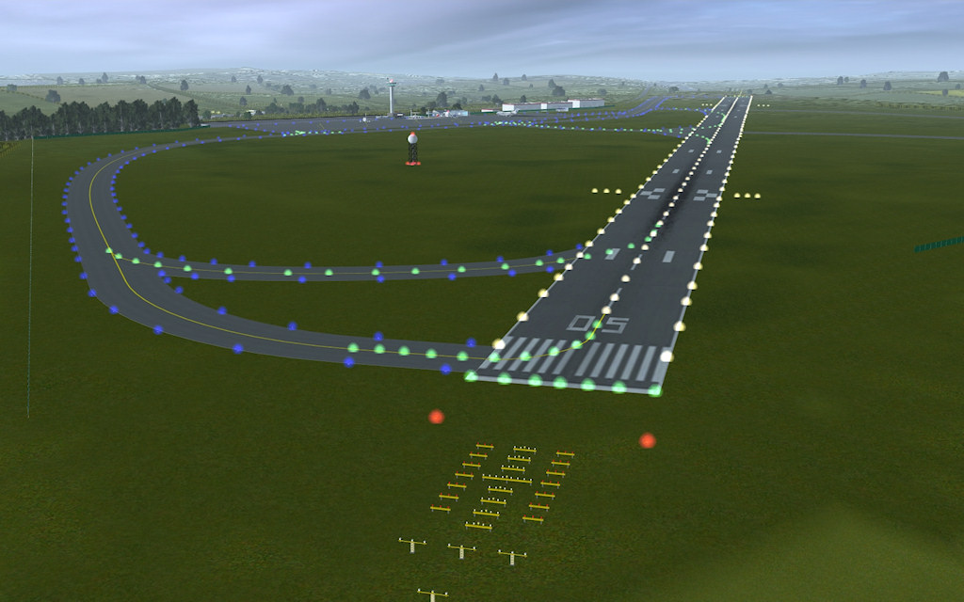

Slide 75
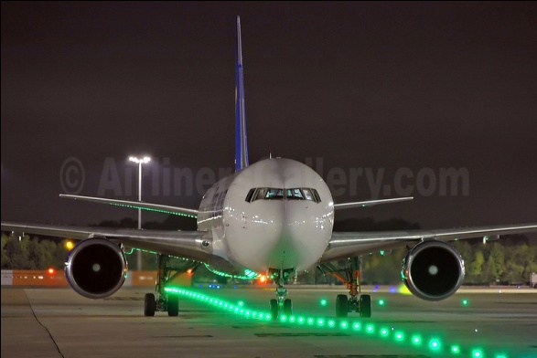

Slide 76
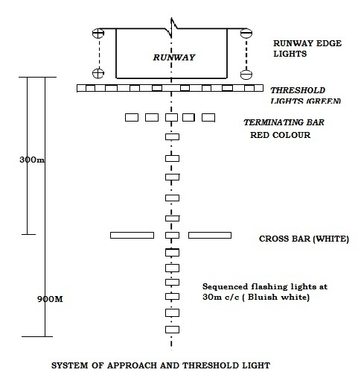

Slide 77
Best pictures of airport

Slide 78


Slide 79


Slide 80


Slide 81


Slide 82


Slide 83


Slide 84


Slide 85


Slide 86


